Slide 1


Module 5: Deployment
Developing Business Applications with

Slide 2

Aims and context
When to invest in deployment automation?
Why automate deployments?
Hosting considerations
Exercises
Notes:
<use this slide for agenda>

Slide 3
Aims and context

Slide 4




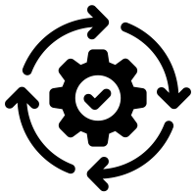



Module 5: Deployment
Browser
Client
WebSocket
Application Services
HTTP
HTTP
Authorization
Server
Web
Server
Job
Orchestrator
Job
Host(s)
Job
Host(s)
HTTP
Job
Host(s)
HTTP
TCP/IP
TCP/IP
HTTP
HTTP
Infrastructure Services
Azure
PostgreSQL
MIKE Cloud
Services
Notes:
At this point, you have working software that you have developed/configured, and it’s time to send it somewhere to be hosted.
The simplest approach is to copy/paste everything where it needs to be, configure firewalls, configure connection strings, configure file paths, install services, start services. Can anyone think of problems with the copy/paste/configure approach?
Simple vs powerful? It depends. A more powerful approach is to learn how these tasks can be automated, and whether this is worth your while for your project.

Slide 5
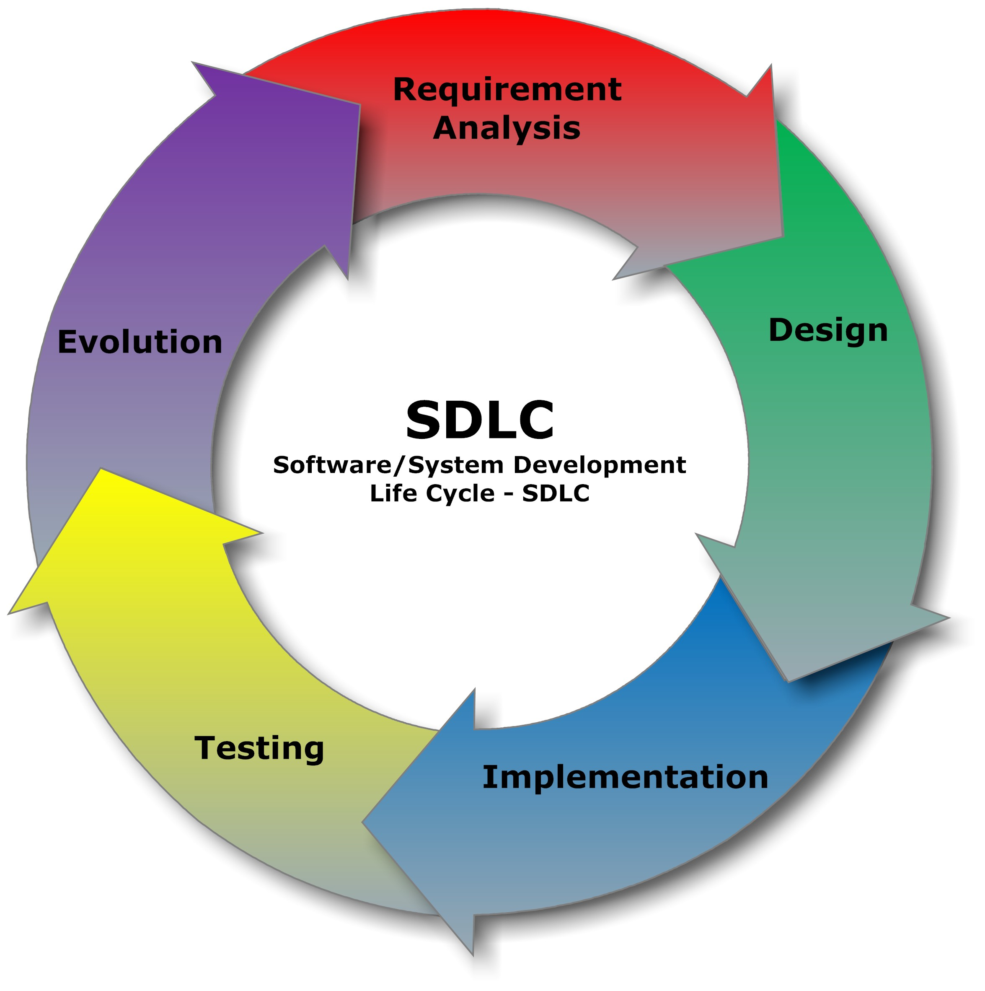

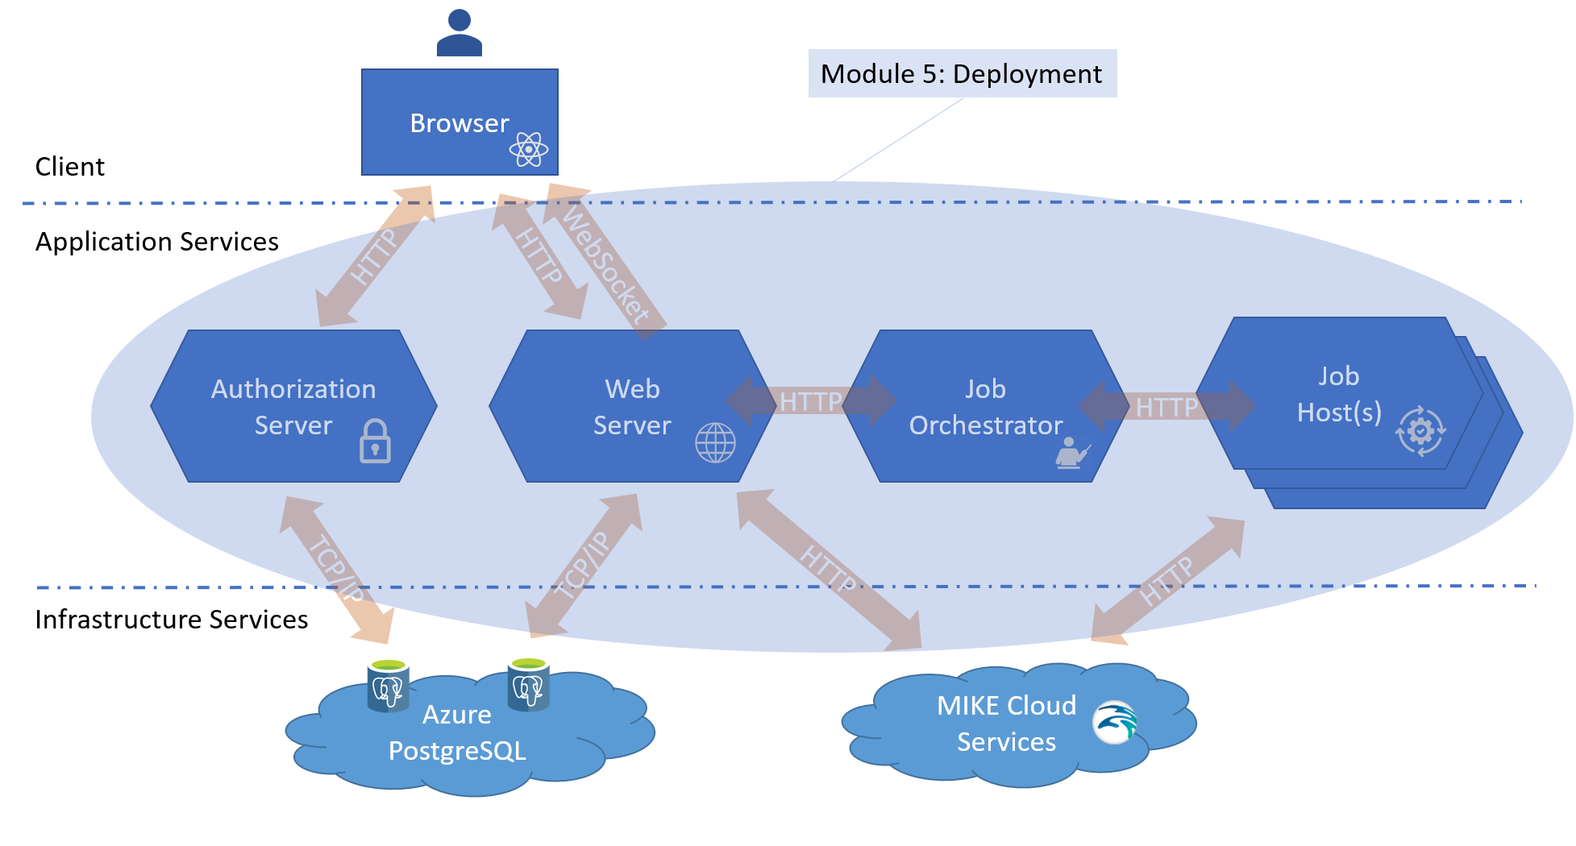
When to invest in deployment automation?
Project lifecycle
Team size/capability
Component count/interlinks
Notes:
A small/single person team may only need to perform a few deployments and can do this manually. In my case, deployment automation is low friction enough that I apply it even on a single person team (it helps greatly as a form of deployment documentation). As your project portfolio grows, you tend to forget the exact deployment details of projects you worked on years ago.
Increased trend of continuous integration and development, showing small progress steps and getting rapid feedback, improved agility. In the past the practice was much more to perform a single bug deployment at the very end of a project.
Each component that you deploy usually requires some configuration (connection strings, environment variables, file paths etc). A simple project with 1 or 2 components and very little configuration would benefit less than a more complex project with many interlinked components.

Slide 6


Why automate deployments?
Focus on harder problems
Resilience
Agility
Notes:
Allows your team to focus on harder problems
Brings resilience to your team (deployment can happen while some team members are unavailable)
Reduces time spent for small fixes that must be instantly deployed

Slide 7


Why automate deployments?
Documentation
Improves testability
Allows for flexibility in process
Notes:
Documents your deployment process
Highlights specific config that can be made generic which improves testability
Allows for non-dev engagement in deploy eg: product owner approval

Slide 8
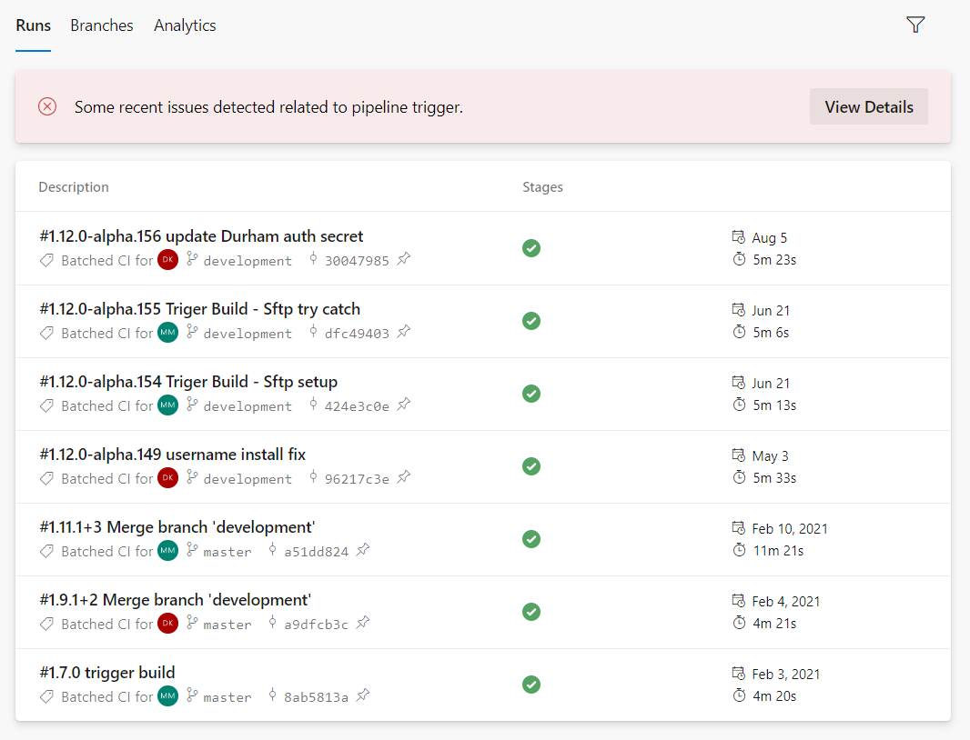

Why automate deployments?
Improved visibility into status
Easier rollback
More powerful deployment scenarios eg: blue/green; dev/staging/prod
Notes:
Improved visibility into status
Which version is deployed in dev/stag/prod?
Has my issue been fixed?
Can the customer see the fix to my issue?
How long does the build take?
How long does deploy take?
Easier rollback, but always be careful about rolling back to a version no longer compatible with the data
More powerful deployment scenarios eg: blue/green; dev/staging/prod

Slide 9

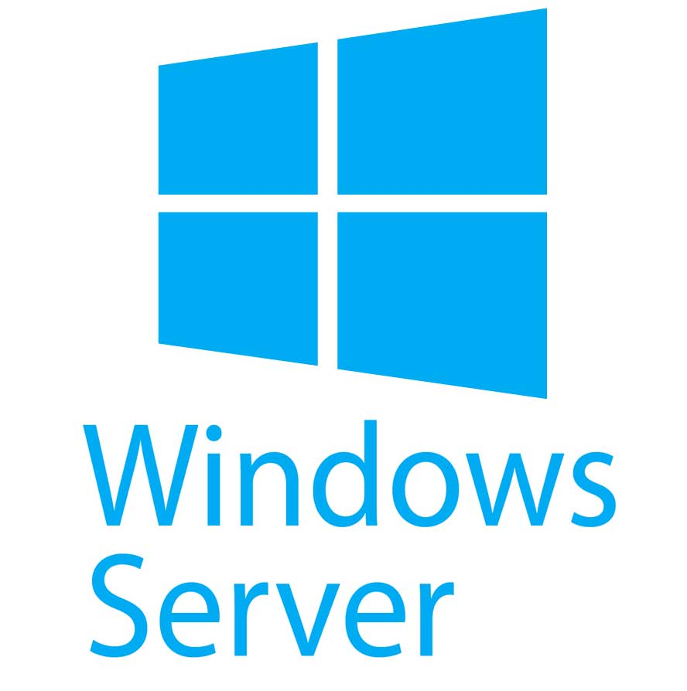



Hosting Considerations
Cloud service
Server
Notes:
Cloud service eg: Azure App Service, usually has a simpler deployment process involving file copy, can be more expensive if costs not controlled
Server eg: Windows Server, usually requires the developer to take more steps to complete a deployment, often required when deploying to client’s IT datacenters
Early consultation with client IT can make a lot of decisions for you

Slide 10
Hosting Considerations
Component | Cloud Service | Windows Server | Docker Container *
Database | Azure PostgreSQL/Others? | PostgreSQL | Possible but usually applied to stateless scalable apps
Frontend web app | Azure Blob Static Site/GitHub Pages/Others? | IIS/Nginx | Usually not worth it for lower traffic levels, but the packaging advantage is nice
Auth/API web service | Azure App Service/Others? | IIS/Kestrel | Usually not worth it for lower traffic levels, but the packaging advantage is nice
Job orchestrator |  | Windows Service (may be decoupled soon)
Job host |  | Windows Service (almost always requires Windows due to MIKE models)
* docker containers still require hosting/orchestration which is not discussed here
Notes:
Hosting options
Database
Cloud service eg: Azure PostgreSQL
Windows Server
Docker container, but usually applied to stateless scalable apps
Frontend web app
Cloud service eg: Azure Blob Static Site
Windows Server IIS/Nginx
Docker container, hosted in cloud eg: AKS, or on self managed servers (not likely worth it for DHI levels of frontend traffic)
Auth/Web API server
Cloud service eg: Azure App Service
Windows Server IIS
Docker Container, hosted in cloud eg: AKS, or on self managed servers (not likely worth it for DHI levels of API traffic)
Job orchestrator
Windows Server (required, but may be decoupled in near future)
Job host
Windows Server (almost always requires Windows due to MIKE models)

Slide 11

Notes:
<use this slide for breaks>

Slide 12
Deployment Tools
gitversion – stamps your built package with an automatically generated version number
GitHub Actions/Azure DevOps Pipeline – compiles code, deploys to cloud, builds packages
Chocolatey – automates/installs packages on Windows
GitHub Packages/Azure DevOps Artifacts – package repository

Slide 13
Assignments
Create a github workflow to build and publish frontend to github pages
Create a github workflow that builds a choco package that deploys to/from package repository
Stamp your build with an auto incrementing version number
Package reads a secret connection string

Slide 14
Frontend Deployment Assignment
Perform the following in your personal (non-DHI) GitHub DomainServicesCourse fork
Go to Settings -> Secrets -> Actions -> New repository secret
Name: NPM_TOKEN
Value: token that you generated in Module 4 Frontend from these instructions https://github.com/DHI/react-components/blob/master/packages/react-components/README.md
Go to Actions -> Enable workflows in this repository
Select the webdeploy workflow -> Run workflow
Go to Settings -> Pages -> Branch -> select gh-pages -> Save
Go to Actions, another workflow called pages-build-deployment should automatically run
When complete, go to the Settings -> Pages and your site URL will be listed
Your site should now be functioning on GitHub Pages just as it was on your dev PC
Notice the version number (dev) in the app bar is not helpful, let’s address that next

Slide 15
Frontend Deployment Assignment
Add and commit a new file GitVersion.yml to the root of your repository with the following content
mode: Mainline
branches: {}
ignore:
sha: []
merge-message-formats: {}
This controls the numbering approach that will be calculated by GitVersion. There are many different numbering approaches offered by GitVersion, but this is a simple increment

Slide 16
Frontend Deployment Assignment
Modify the webdeploy.yml file to overwrite the /Public/version.txt file with a GitVersion number, by including this code before the Install and Build step
- name: Install GitVersion
uses: gittools/actions/gitversion/setup@v0.9.7
with:
versionSpec: '5.5.0'
- name: Determine Build Version
id: gitversion
uses: gittools/actions/gitversion/execute@v0.9.7
- name: Display Build Version
run: |
echo "Build version: ${{ steps.gitversion.outputs.semVer }}"
echo "${{ steps.gitversion.outputs.semVer }}" > ./Source/Frontend/public/version.txt
Commit, run the webdeploy workflow, wait for deploy, verify that the new version number you added appears in the app bar
Make another commit, run the webdeploy workflow, verify that the version number has incremented automatically

Slide 17
Backend Deployment Assignment
In your public github repo, open the template choco package
Fill in name, paths, install, uninstall
Create a workflow to build and send to package
Install the package on your machine

